Slide 1
Minecraft with Intel Inside
Farzon Lotfi

Slide 2
Presentation Goals
To define Goals
To explain which goals were reached and how to a technical audience

Slide 3
Defined Goals
P1– Mod Java x86 Minecraft to Live stream to Youtube with Media SDK and capture audio commentary without framerate impact or battery life, SNB, IVB, HSW, Clovertrail, Baytrail
P1 - Capture to file with Media SDK for later upload
P1 - Add “Powered by Intel Media SDK” watermark to all videos, and comments section for automated Youtube upload
P2 – Integration with Twitch - http://www.twitch.tv/p/developers
P2 – Sample for PerC integration of control
P2 – Work with Mojang [publisher] to integrate into main branch of game

Slide 4
Goals Status
P1 -stream to youtube was not possible as the feature is not available to everyone, but might be in the next few months http://www.engadget.com/2013/08/04/youtube-opens-live-streaming-to-channels-with-100-subs/
P1 – effect on framerate – currently 60 frames has not been achieved with hardware encoding enabled framerate drops to 45 FPS in Minecraft
P1- impact on battery is only 10 min better than software in our test to 50% battery, that’s based on 1 test run.
P1- platforms tested on have only been ivybridge
P1- capture to a file has been achieved, video sync issues persist that will be covered in the bug section
P1 – watermark has not been started
P2 – twitch integration still in process
P2 – no PerC integration
P2 -did not work with Mojang, project is working off of decompiled binaries

Slide 5
The Architecture: Layered
Minecraft
Native Code called over JNI
JVM
Twitch SDK
In Audio Read
Out Audio Read
OpenGL FBO Read
YouTube SDK
FFMPEG
Media SDK
This project took advantage of a layered and pipelined software architecture.
All c++ code is compiled to a DLL and linked into Minecraft using JNI
As of this writing all that remains are YouTube and Twitch integration and bug fixes

Slide 6

The Architecture: Pipelined
Video Encoding pipeline
Intel® Media SDK (video)
FBO Read
VPP
Encode
Spawn 2 threads
FFMPEG Mux
File
Mic Read
Process
Encode
System IO
mp4, wmv etc.
Speaker Read
Process
Encode
= Media SDK component
This project has 4 main pipelines (1. in audio, 2. out audio, 3. OpenGL pipeline, & 4. the Media SDK encoder pipeline
The diagram above simplifies these sub pipelines into the one pipeline in which all of these individual components is used.

Slide 7
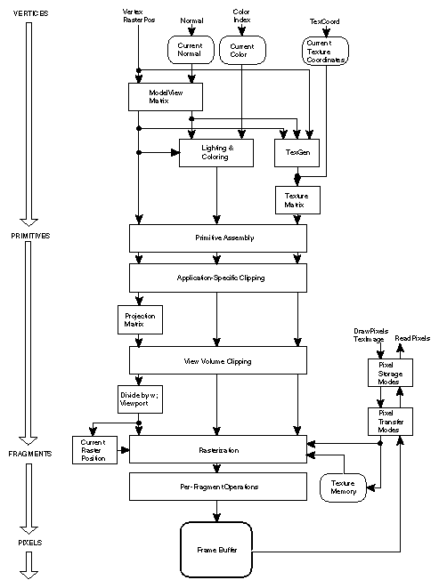
OpenGL FBO Pipeline
This part of the code is set in 3 stages first an off-screen FBO has to be setup and intercept the OpenGL Frame Buffer
This part of the code must occur before any draw calls are made
Now all the draw calls will write to the FBO
Then We need to setup a double buffered PBO that the GL_ReadPixels call can asynchronously read from
Then We need to write back to the GL_BackBuffer so that we are never writing to the currently shown frame (which would cause tearing)

Slide 8
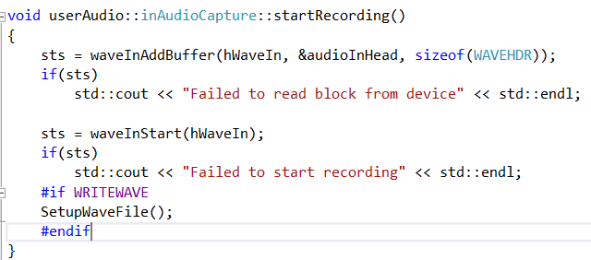
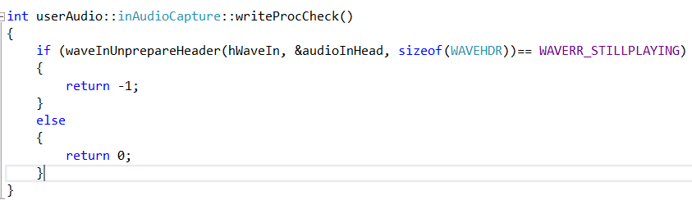
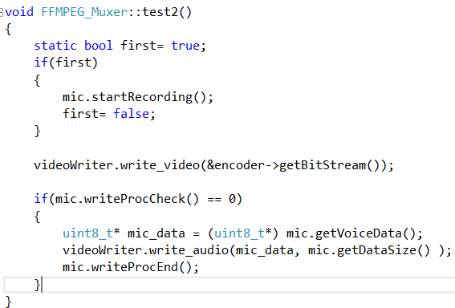
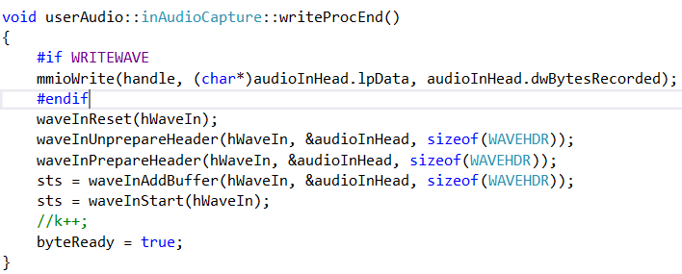
In Audio
Before the Pipeline Starts a wave buffer needs to be created and initialized
Then in a loop the buffer is checked until it is full and then written to a file and reset
This is done in four stages 1. startRecording(), 2. writeProcCheck(), 3. write_audio(), & writeProcEnd(). This is all shown in the test2() function which currently sequential.

Slide 9
Msdk Encoder
This part of the code puts all the default encoder functionality like creating the session and initializing the encoder in an abstract class
Then subclasses specialized for the type of data we want to encoded
Subclasses were made for bitblit, dx9, dx10, and openGL

Slide 10
Out Audio
This is the only portion of the code that is not included in the muxer it is code complete but not used.
Uses the windows audio api
it only records when a noise is made so silence is never captured

Slide 11
FFMPEG Muxer
At the time an audio encoder and container muxer were not available
To make do the team used FFMPEG instead
Code has 4 steps the first 3 are initialization steps
1. register codecs and set container, 2. add streams audio and video, 3. open the streams, 4. write the streams to the container as frames/packets become available.

Slide 12
Bugs
Color Conversion
Quality Degradation
Evenly spaced Audio artifacts (blips)
Video Sync

Slide 13
Color Conversion
The Windows Version of OpenGL does color conversions between GL_RGBA and GL_BGRA inefficiently.
This conversion cuts the frame rate of this Screen cap library in half.
As a result an unsupported color format has to be used which means the VPP (Video Preprocessing) portion of the code needs to be replaced with IPP (Intel performance primitives) [http://software.intel.com/sites/default/files/m/d/4/1/d/8/UnspColorConv-MediaSDK.pdf].

Slide 14
Quality Degradation
This seems to be a bug only in one of my samples
After some extensive testing The bug seems to be in the hardware encoder.
It has been reproduced on another ivybridge machine and the bug has been reported.
It does not appear to be an issue in minecraft

Slide 15
Audio Artifacts
This might be a buffer that is not completely filled
More time is needed to narrow the causes of the glitch.

Slide 16
Video Sync
Almost completely solved a few frames still seem to be off.

Slide 17
Limitations
At the moment, the encoding does not scale to increasing video sizes
Limitation on frame sizes supported at the moment, must be even numbers that when divided by 2 are still even (FFMPEG limitation).

